Slide 1
Online Complaint Registration and Management System
Streamlining complaint handling for better customer experience
Team members:
A.Vishnu Priya (leader)
Mythili.D
Jefflin Biniksha.V.S
Dhanya.S.S

Slide 2
Project Overview
Purpose: An online platform that allows users to register and manage complaints effectively.
Objective: To optimize complaint handling processes, improve customer satisfaction, and streamline communication between customers and agents.
Key Features:
User Registration and Login
Complaint Submission and Tracking
Real-time Interaction with Agents
Admin Control and Monitoring
Security and Confidentiality Measures

Slide 3
Problem Statement
Challenges:
Manual complaint handling is time-consuming and error-prone.
Lack of centralized tracking leads to inefficiency and customer dissatisfaction.
Communication between users and agents is often delayed.
Solution:
Create an online platform to automate and centralize the complaint management process.

Slide 4
Key Features
User Registration and Authentication:
Allows users to securely create accounts and login using JWT authentication.
Complaint Submission:
Users can submit complaints with necessary details like description, issue category, and attachments.
Tracking and Notifications:
Users can track complaint progress and receive email/SMS notifications.
Real-time Chat:
Enables direct messaging between users and agents for quicker issue resolution.
Admin Management:
Admins can assign complaints to agents, oversee operations, and ensure compliance.

Slide 5
User Roles
User:
Registers, submits complaints, and communicates with agents.
Agent:
Assigned to handle complaints and communicate with users to resolve issues.
Admin:
Oversees the system, manages users, assigns complaints, and ensures smooth operations.

Slide 6
Project Architecture
Frontend:
Built with React.js.
Responsive and user-friendly UI with real-time chat functionality using Socket.io.
API requests handled by Axios for seamless communication with backend.
Backend:
Built with Node.js and Express.js.
RESTful API for handling data operations and complaint management.
Database:
MongoDB for efficient and scalable storage of user data, complaints, and chat messages.
Nodemailer for sending email notifications to users.

Slide 7
Technology Stack
Frontend: React.js, Bootstrap, Axios, Socket.io
Backend: Node.js, Express.js
Database: MongoDB
Additional Tools: Nodemailer (for email), Socket.io (for real-time messaging), JSON Web Token (JWT) for secure authentication

Slide 8
Challenges and Solutions
Challenge: Implementing real-time chat without performance issues.
Solution: Used Socket.io to handle real-time messaging efficiently.
Challenge: Ensuring data security and privacy.
Solution: Implemented JWT for secure authentication and role-based access control.
Challenge: Seamless deployment across different platforms.
Solution: Used Heroku for backend and Netlify/Vercel for frontend deployment.

Slide 9
System Flow Diagram
User Registration/Login → Complaint Submission → Admin Assignment → Agent Handling → Real-Time Chat → Resolution and Feedback
Use a flowchart or diagram to visually represent how a complaint is processed from submission to resolution.

Slide 10
Detailed Features
User Registration:
Simple sign-up with email verification.
Complaint Tracking:
Users can view updates on the complaint status in real time.
Notifications:
Email alerts are sent at different complaint stages, like submission, assignment, and resolution.
Admin Panel:
Admins have a dashboard to monitor complaints and assign tasks to agents.
Real-Time Chat:
Immediate communication between users and agents improves response time.

Slide 11
Database Structure
Users Collection:
Fields: name, email, password, role (user, agent, admin).
Complaints Collection:
Fields: title, description, status, assignedAgent, messages[].
Messages within Complaints:
Real-time chat with sender, message, and timestamp fields.

Slide 12
Security and Privacy
Authentication:
Secure login with JWT (JSON Web Tokens).
Authorization:
Role-based access control (user, agent, admin).
Data Privacy:
Complaint data is accessible only to relevant users (user, agent, admin).
Compliance:
Follows data protection regulations for storing user information securely.

Slide 13
Demo and Screenshots
Provide screenshots or a live demo of the application:
User Registration/Login Page
Complaint Submission Form
Complaint Tracking Dashboard
Real-Time Chat Interface
Admin Dashboard

Slide 14
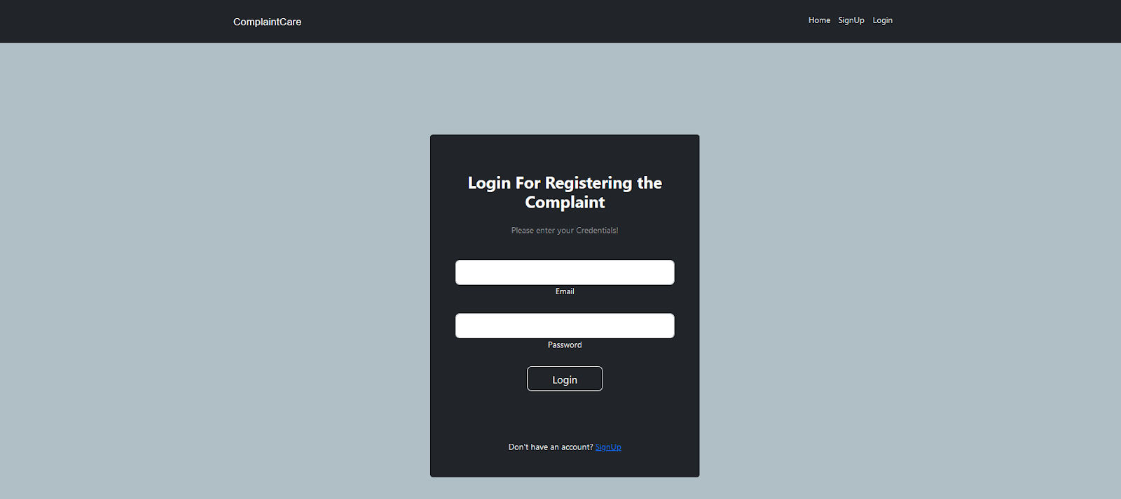

Slide 15
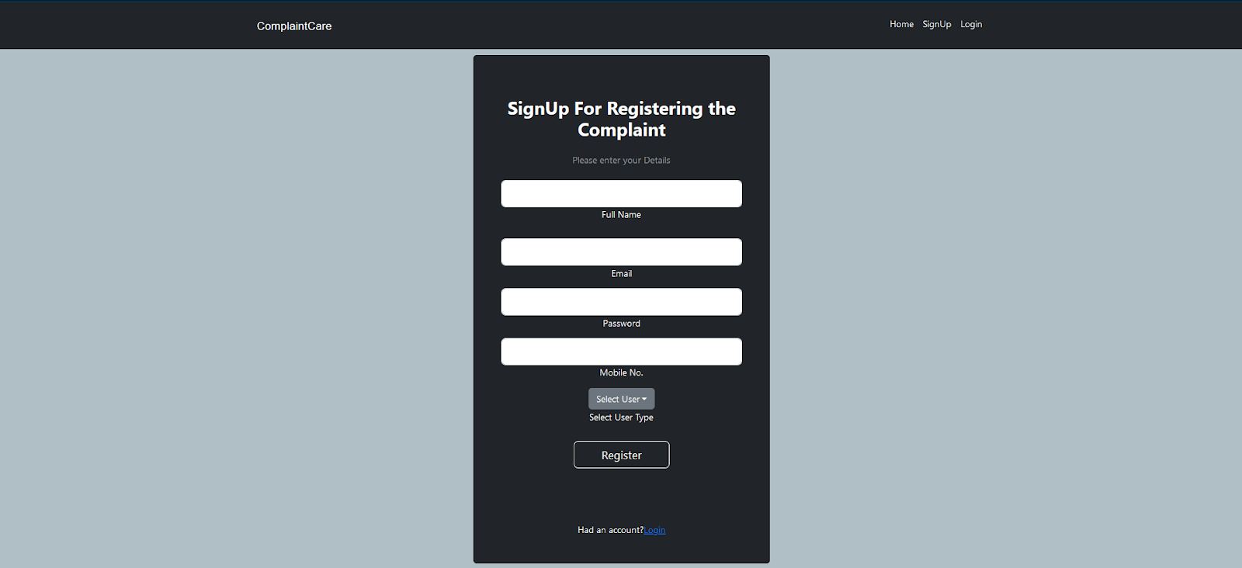

Slide 16
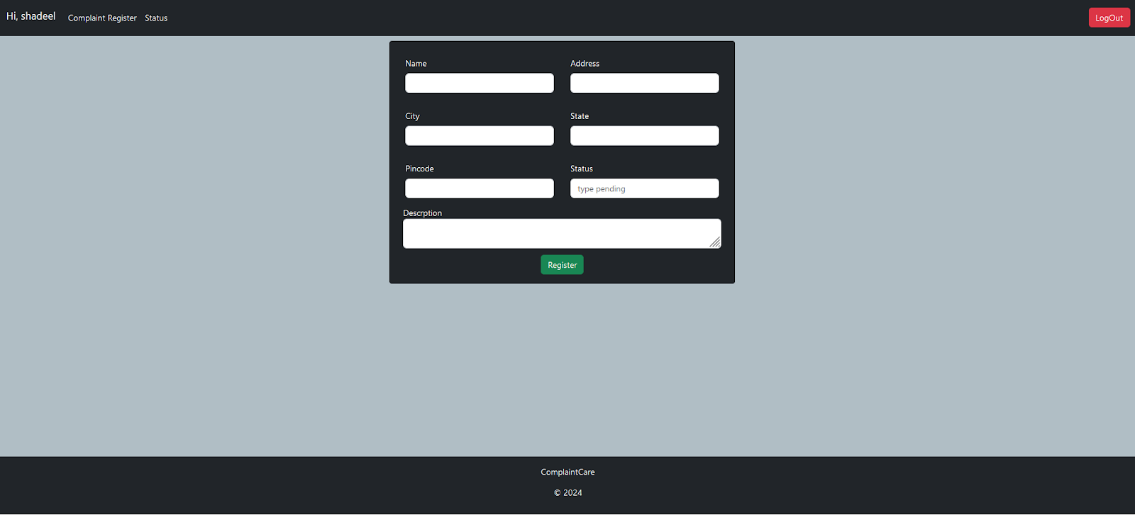

Slide 17
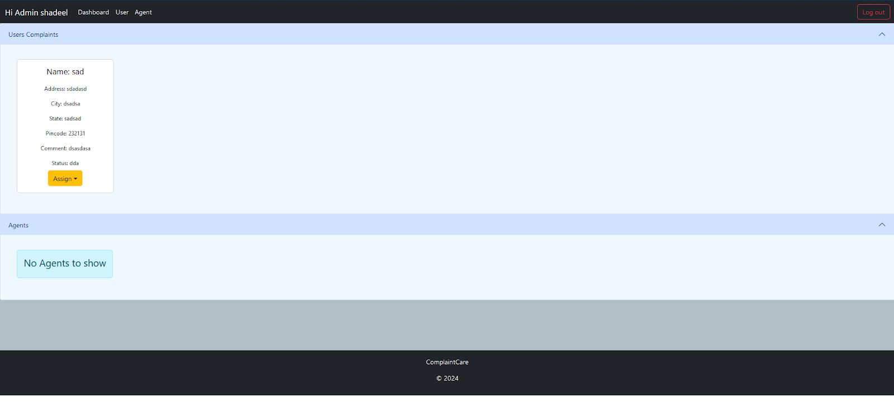

Slide 18
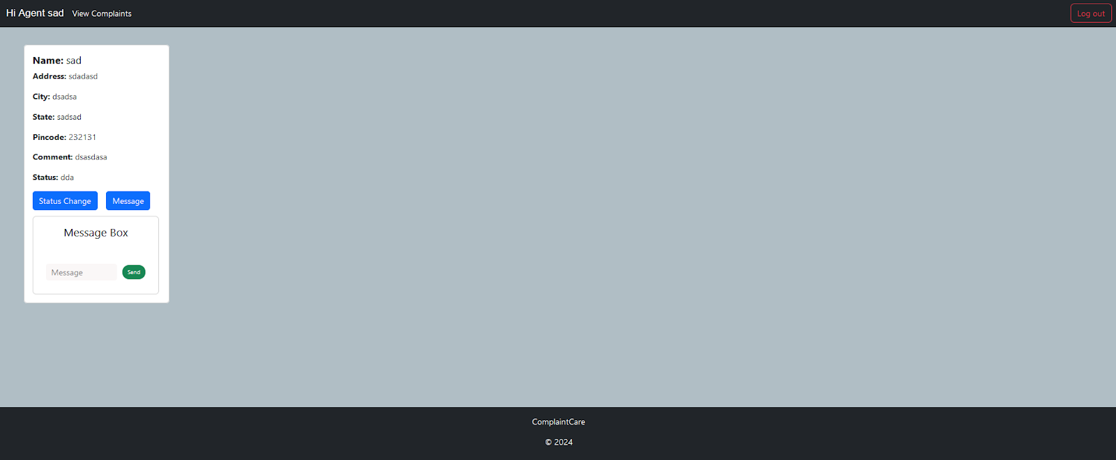

Slide 19
Testing and Validation
Testing Types:
Unit Testing: Test individual components like registration, complaint submission.
Integration Testing: Ensure all system parts work together.
User Testing: Gather feedback on user experience, ease of use, and UI.
Tools Used: Postman (API testing), Jest/Mocha (unit testing).

Slide 20
Future Enhancements
Mobile Application: Develop a mobile app for easier access.
Multi-language Support: Add language options for broader accessibility.
Analytics and Reporting: Generate reports for complaint trends and agent performance.
AI-Based Complaint Assignment: Use AI to route complaints based on nature and agent availability.

Slide 21
Conclusion
Summary:
This system streamlines complaint handling, enhances customer satisfaction, and ensures data security.
Key Takeaways:
Efficient, real-time complaint resolution system.
Scalable and secure, with clear role-based access.

